Slide 1
DS 2002
Capstone Project
DS 2002
04/30/2026
Kendall Freese, Riley Goetz, Maddie Schermerhorn, Sibel Bulut

Slide 2
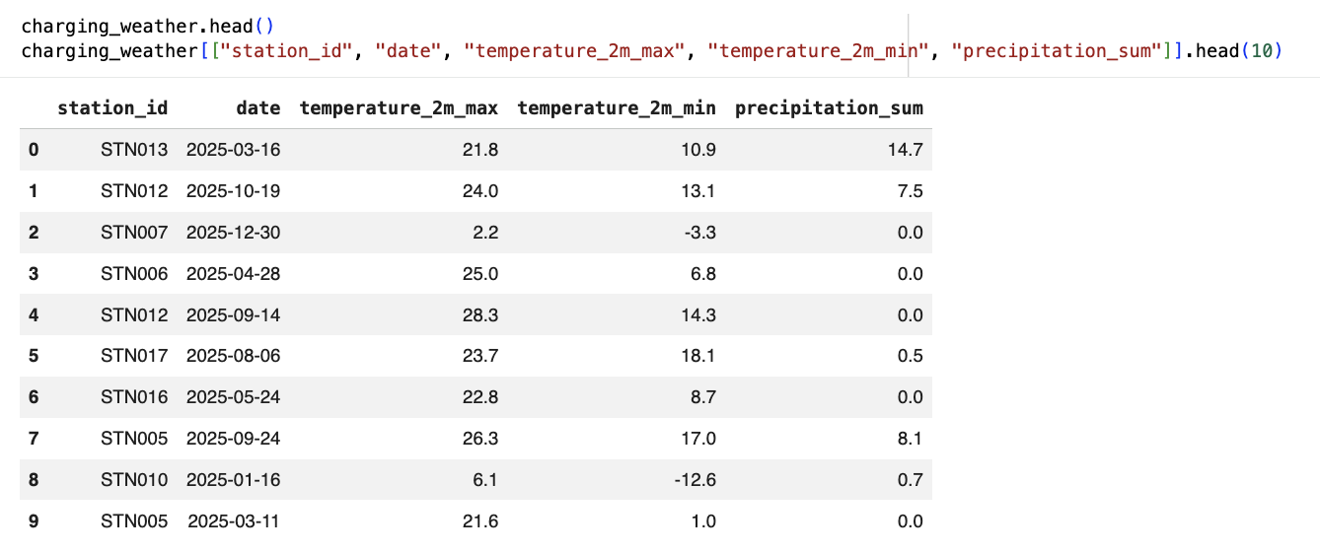
Pipeline
Cloud + API Integration
Authenticated with Google Cloud Storage (GCS)
Loaded raw data from cloud bucket
Integrated external weather API (Open-Metro)
Merged weather data with charging sessions + demand data
Saved final cleaned dataset to SQLite + GCS
GCS → Data Cleaning → Weather API → Merge → Final Dataset → Upload to GCS

Slide 3
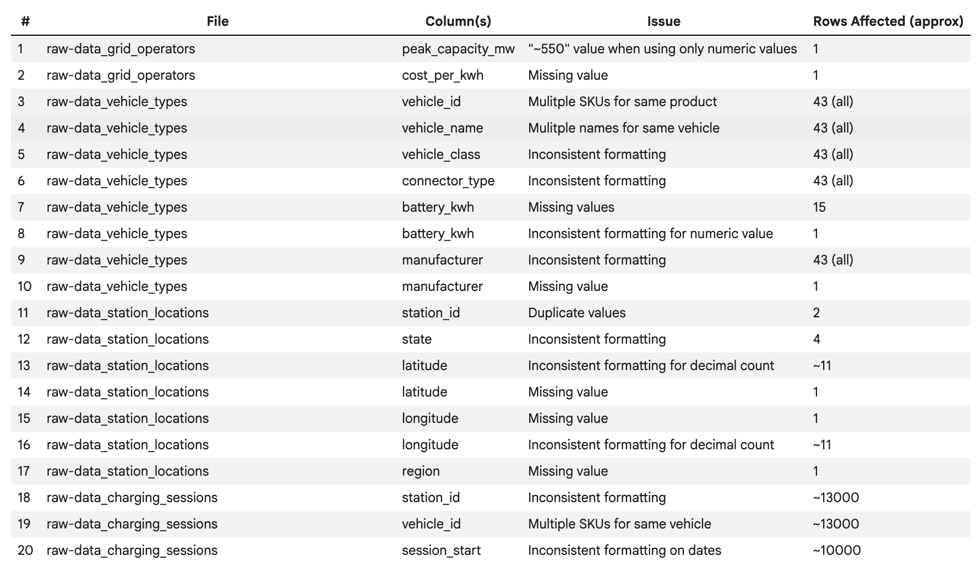
Cleaning
2 Cleaning Decisions: Mixed datetime formats and Inconsistent station ID formatting
General data quality issues: inconsistent formatting, fragmented identifiers, duplicate records, invalid values, categorical inconsistencies, missing data
Data cleaning changes: removed duplicate records, standardized datetime formats, normalized text fields, standardized IDs into consistent formatting, fixed inconsistent categorical values, converted numeric fields into proper data types, handled missing values, removed invalid values, ensured reliable joining across tables
General trade-off: Data Retention v. Strict Consistency

Slide 4
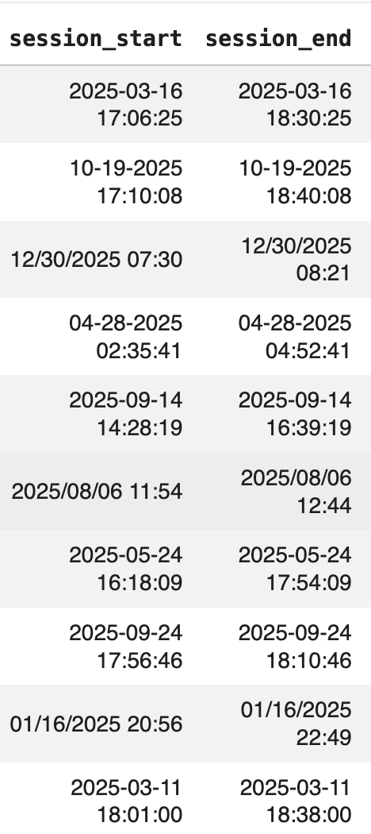
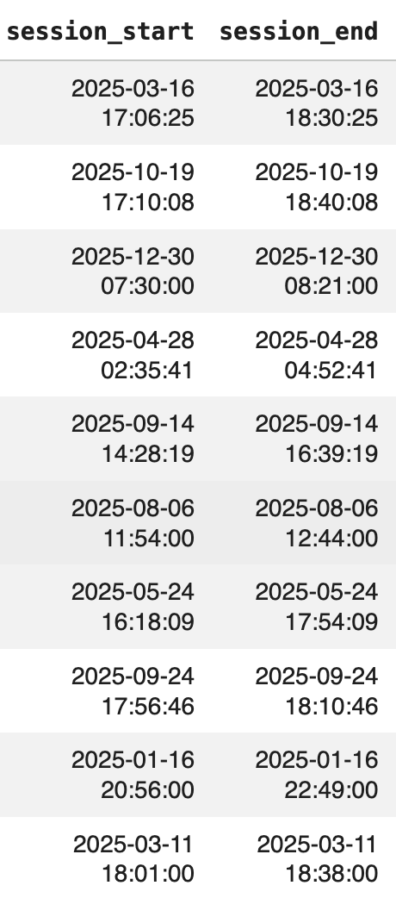
Cleaning
Mixed Datetime Formats
Before: session_start and session_end had multiple inconsistent formats → 2025-03-16 17:06:25, 10-19-2025 17:10:08, 12/30/2025 07:30, 2025/08/06 11:54
Decision: Implemented a mixed-format datetime parser to standardize timestamps into consistent format →YYYY-MM-DD HH:MM:SS
After: all timestamp data was preserved and converted into consistent formatting
Impact: Created intreptable datetime data to aid in analysis and discover key relationships
Trade-off: data retention & consistent formatting with small risk of incorrectly interprtting date formats

Slide 5
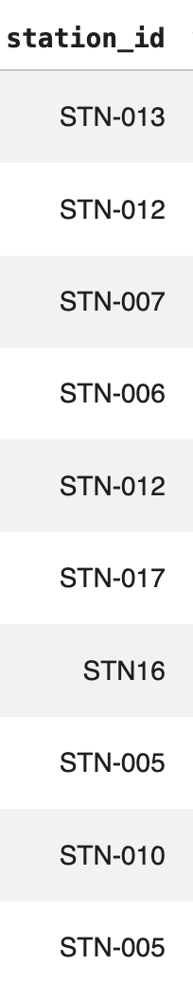
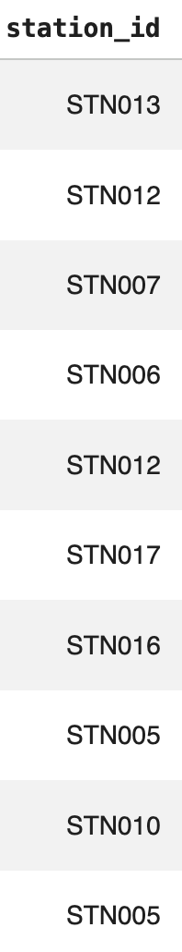
Cleaning
Inconsistent Station ID Formatting
Before: station IDs appeared in inconsistent formats → STN16, STN5, STN016
Decision: Standardized all station IDs to a fixed format STN### → STN16 to STN016
After: All station IDs follow a consistent format
Impact: Reliable joins across dataset and prevents risk of mismatching values
Trade-off: Consistency prioritzed to ensure accurate joining but follows assumption that station IDs follow the same naming conventions

Slide 6

Analysis:
Charging Demand, Weather, and Connector Types
DS 2002
4/30/2026
We analyzed EV charging data to understand usage patterns, external factors, and infrastructure needs.
Q1: Demand surge identification
Q2: Vehicle consolidation and true charging usage
Q3: Weather effects on charging demand and grid load
Q5: Connector type trends and recommendation

Slide 7
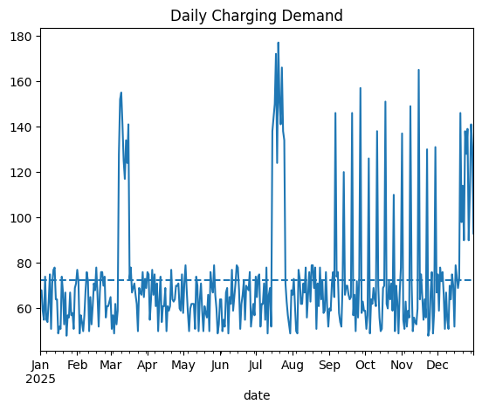
Demand Surge Identification
Baseline: ~70 sessions per day
Peak demand occurs in late July–August (~170–180 sessions)
Repeated spikes in fall (Sep–Dec)

Slide 8
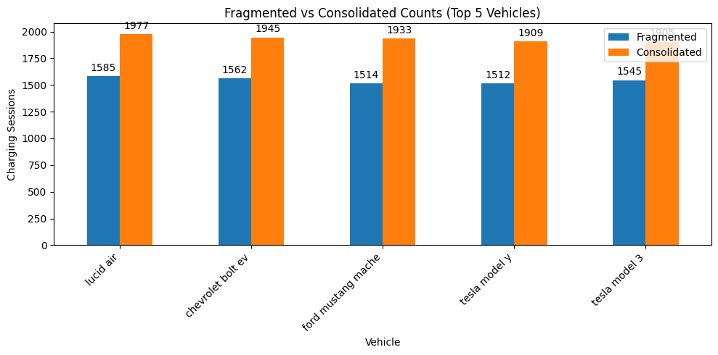
Vehicle Consolidation Problem
DS 2002
4/30/2026
Some vehicles are split across multiple IDs
“Fragmented” = only highest single ID count
“Consolidated” = total across all IDs
Differences between fragmented and consolidated counts show that raw data underestimates charging demand for each vehicle.

Slide 9
Impact of Consolidation
What the data shows
DS 2002
4/30/2026
Consolidated counts are significantly higher for every vehicle
Data cleaning directly changes conclusions
Each vehicle is undercounted when IDs are split
Important for accurate demand planning
Differences are around ~300-500 sessions per vehicle
Raw data would underestimate true demand

Slide 10
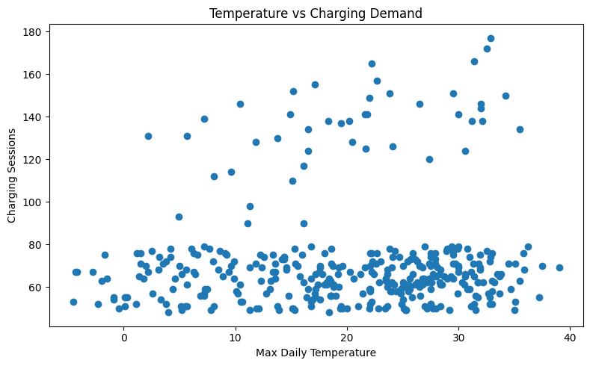
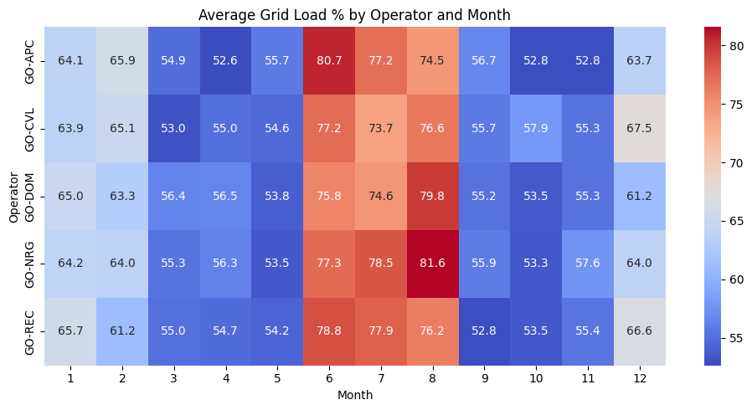
Weather and Charging Demand
DS 2002
4/30/2026
Temperature vs. Daily Charging Sessions
Average Grid Load by Month
Weak relationship between temperature and charging
Grid load varies strongly by month

Slide 11
Key Findings From Weather and Charging Demand
DS 2002
4/30/2026
Temperature does not strongly predict charging demand
Charging levels stay fairly consistent across temperatures
Grid load peaks in summer (June - August)
Seasonal demand has a larger impact than daily temperature

Slide 12
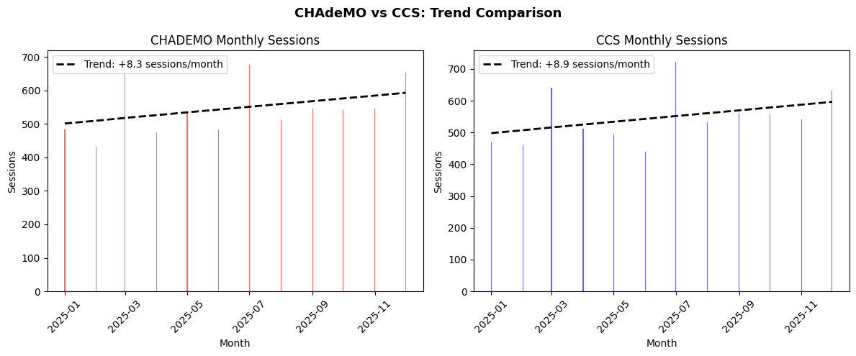
Connector Type Investigation
DS 2002
4/30/2026
CHAdeMO
CCS

Slide 13
Connector Type Investigation
DS 2002
4/30/2026
Evidence
Recommendation
Both connector types are growing at nearly identical rates. This means the apparent CHAdeMO decline suggested by the overall session counts is most likely a data artifact.
Based on this data, there is no strong case to cut CHAdeMO funding. A reasonable approach is to maintain existing CHAdeMO ports but direct any new infrastructure investment toward CCS, which has stronger long-term manufacturer support as newer EVs support CCS more.
Based on the actual trend data, CHAdeMO is not declining:
CHAdeMO slope: +8.33 sessions/month
A positive slope, suggesting growth.
CCS slope: +8.94 sessions/month
A positive slope, suggesting growth.

Slide 14
Thank you!

